Slide 1
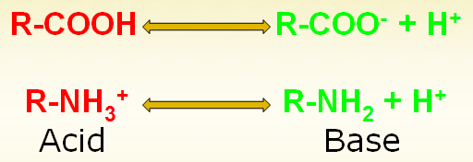
1- Amphoterism (Acid-Base Properties)
Physical and chemical properties
The amphoteric substance is that:
1. act as an acid when a base added to it and as a base when an acid is added to it.
2. Amphoteric properties of amino acids are due to the presence basic group (NH₂) and acidic group (COOH) in each amino acid

Slide 2
2-Zwitter ion or Dipolar ion formation
The form of amino acid that carrying equal number of (+) and (-) charges is electrically neutral and called Zwitter ion or Dipolar ion.
Zwitterion = double ion – when both NH ⁺ and COO⁻ are ionized
3
NH ⁺
3
R C COO⁻
H
Zwitter ion or Dipolar ion

Slide 3
Zwitter ion
Both the –NH2 and the –COOH groups in an amino acid undergo ionization in water.
COO⁻ can accept a proton, NH⁺³ can accept electron, so can act as acid and base (amphoteric)
At the isoelectric point (pI), the + and – charges in the zwitter ion are equal.
Thus, isoelectric point of specific amino acid is that pH at which this amino acid is electrically neutral.

Slide 4
3- Amino acids stereoisomers (Optical activity)
All amino acids except glycine are optically active
They contain an asymmetric carbon atom.
Amino acids have stereoisomers.
In biological systems, only L-amino acids are used in proteins.
COOH
COOH
COOH
COOH
H₂N H CH₃
L-Alanine
H NH₂ CH₃
D-Alanine
H NH₂ CH₂SH
D-Cysteine
H₂N
H
CH₂SH
L-Cysteine

Slide 5
L and D Forms of Amino Acids
COOH
COOH
I
⁺H₃N—C _{α} — H
I
R
I
H—C _{α} —NH⁺₃
I
R
L-Form
D-Form
Amino Acids that have four different chemical groups can exist in two forms (D and L)
What if the R-group is an “H⁺”? Is there going to be an L and D form? (Glycine) No optical activity.
In proteins in mammals (all amino acids are in the L-form)
Are there any D-from amino acids? Yes, synthetics (antibiotics, in plant and bacterial walls)

Slide 6

Glycine is not optical active because it does
not contain asymmetric carbon atom.

Slide 7
4- Effect of the medium pH on ionization of amino acids
- In the acidic medium (pH< 7), all amino acids carry a positive charge
- In basic medium (pH>7) ), all amino acids carry a negative charge
H

Slide 8
Peptides and polypeptides
Peptide is defined as a linear chain that is composed of amino acids residues linked through peptide bonds.
Peptide bond formation:
  Alpha carboxyl group of one amino acid reacts with alpha amino group of another amino acid. Protein are made by polymerization of amino acids through peptide bonds.

Slide 9
Nomenclature for peptides and polypeptides:
The name of a peptide is composed of the names of constituent amino acids in it. For examples
  1. Two amino acids ………… dipeptide
  2. three amino acids ………. tripeptide
  3. four amino acid…………… tetrapeptide
  4. A few amino acids……….. oligopeptide.
  5. combination of 10 to 50 amino acids……. polypeptide.
  6.polypeptide more than 50 amino acids……….. protein

Slide 10
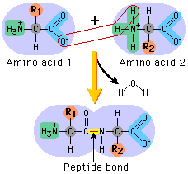
Amino Acids and Peptide Bonds
Carboxyl group and amino group combined to form a peptide bond (in peptides, polypeptides and proteins)

Slide 11
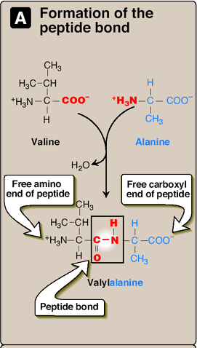
Formation of Peptide Bond
Each peptide/ protein has a one free amino group (N-terminal) and one free carboxyl group (C-terminal)
These two groups are polar and are reactive (involved in formation of hydrogen bonds)
Peptides are read/named from the N-terminal/end to C terminal/ terminal
© Lippincott’s

Slide 12
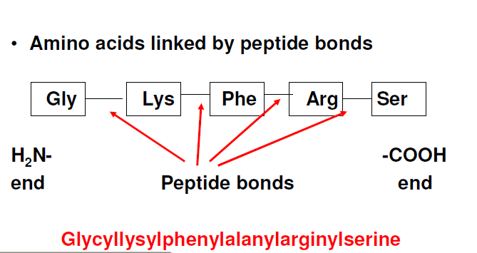

Slide 13
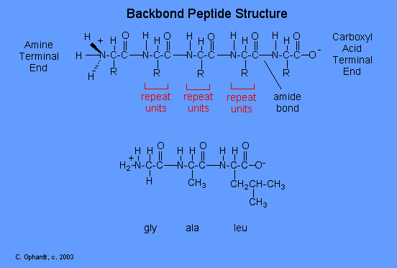
Numbering of Amino acids in protein
Amino terminal end (N-terminal), usually the n-terminal amino acid is written on the left hand side.
Carboxy terminal end (C- terminal)

Slide 14
Peptides/Check
Lysine / glycine / alanine / glutamate / glutamine
How many Amino acids residues in this peptide?
How many peptide bonds?
H₃N- Lys – Gly – Ala – Glu – Gln - COO⁻
N-Terminus
Peptide bonds
C-Terminus
Left ? Free amino group, Right ?free carboxyl group
Remember only one free amino group and one free carboxyl group
Proteins are made of polypeptides (long peptides)

Slide 15
What are the possible tripeptides formed from one each of leucine, glycine, and alanine?
Solution:
Tripeptides possible from one each of leucine, glycine, and alanine
Leu-Gly-Ala
Leu-Ala-Gly
Ala-Leu-Gly
Ala-Gly-Leu
Gly-Ala-Leu
Gly-Leu-Ala

